Slide 1
Mario S. Staller, Swen Koerner, Benni Zaiser
From
Knowledge to
Information
The Marking of Relevance of
Police Use of Force Trainers
& Social Competence Coaches
Seventh Annual Conference of the American Society of Evidence-Based Policing
University of Nevada, Las Vegas, May 15-17th, 2023

Slide 2
*
Prevalence of Myths
Mario S. Staller, Swen Koerner, Benni Zaiser
From
Knowledge to
Information
The Marking of Relevance of
Police Use of Force Trainers
& Social Competence Coaches
Seventh Annual Conference of the American Society of Evidence-Based Policing
University of Nevada, Las Vegas, May 15-17th, 2023
*Same Data -
Different Theoretical Lense

Slide 3
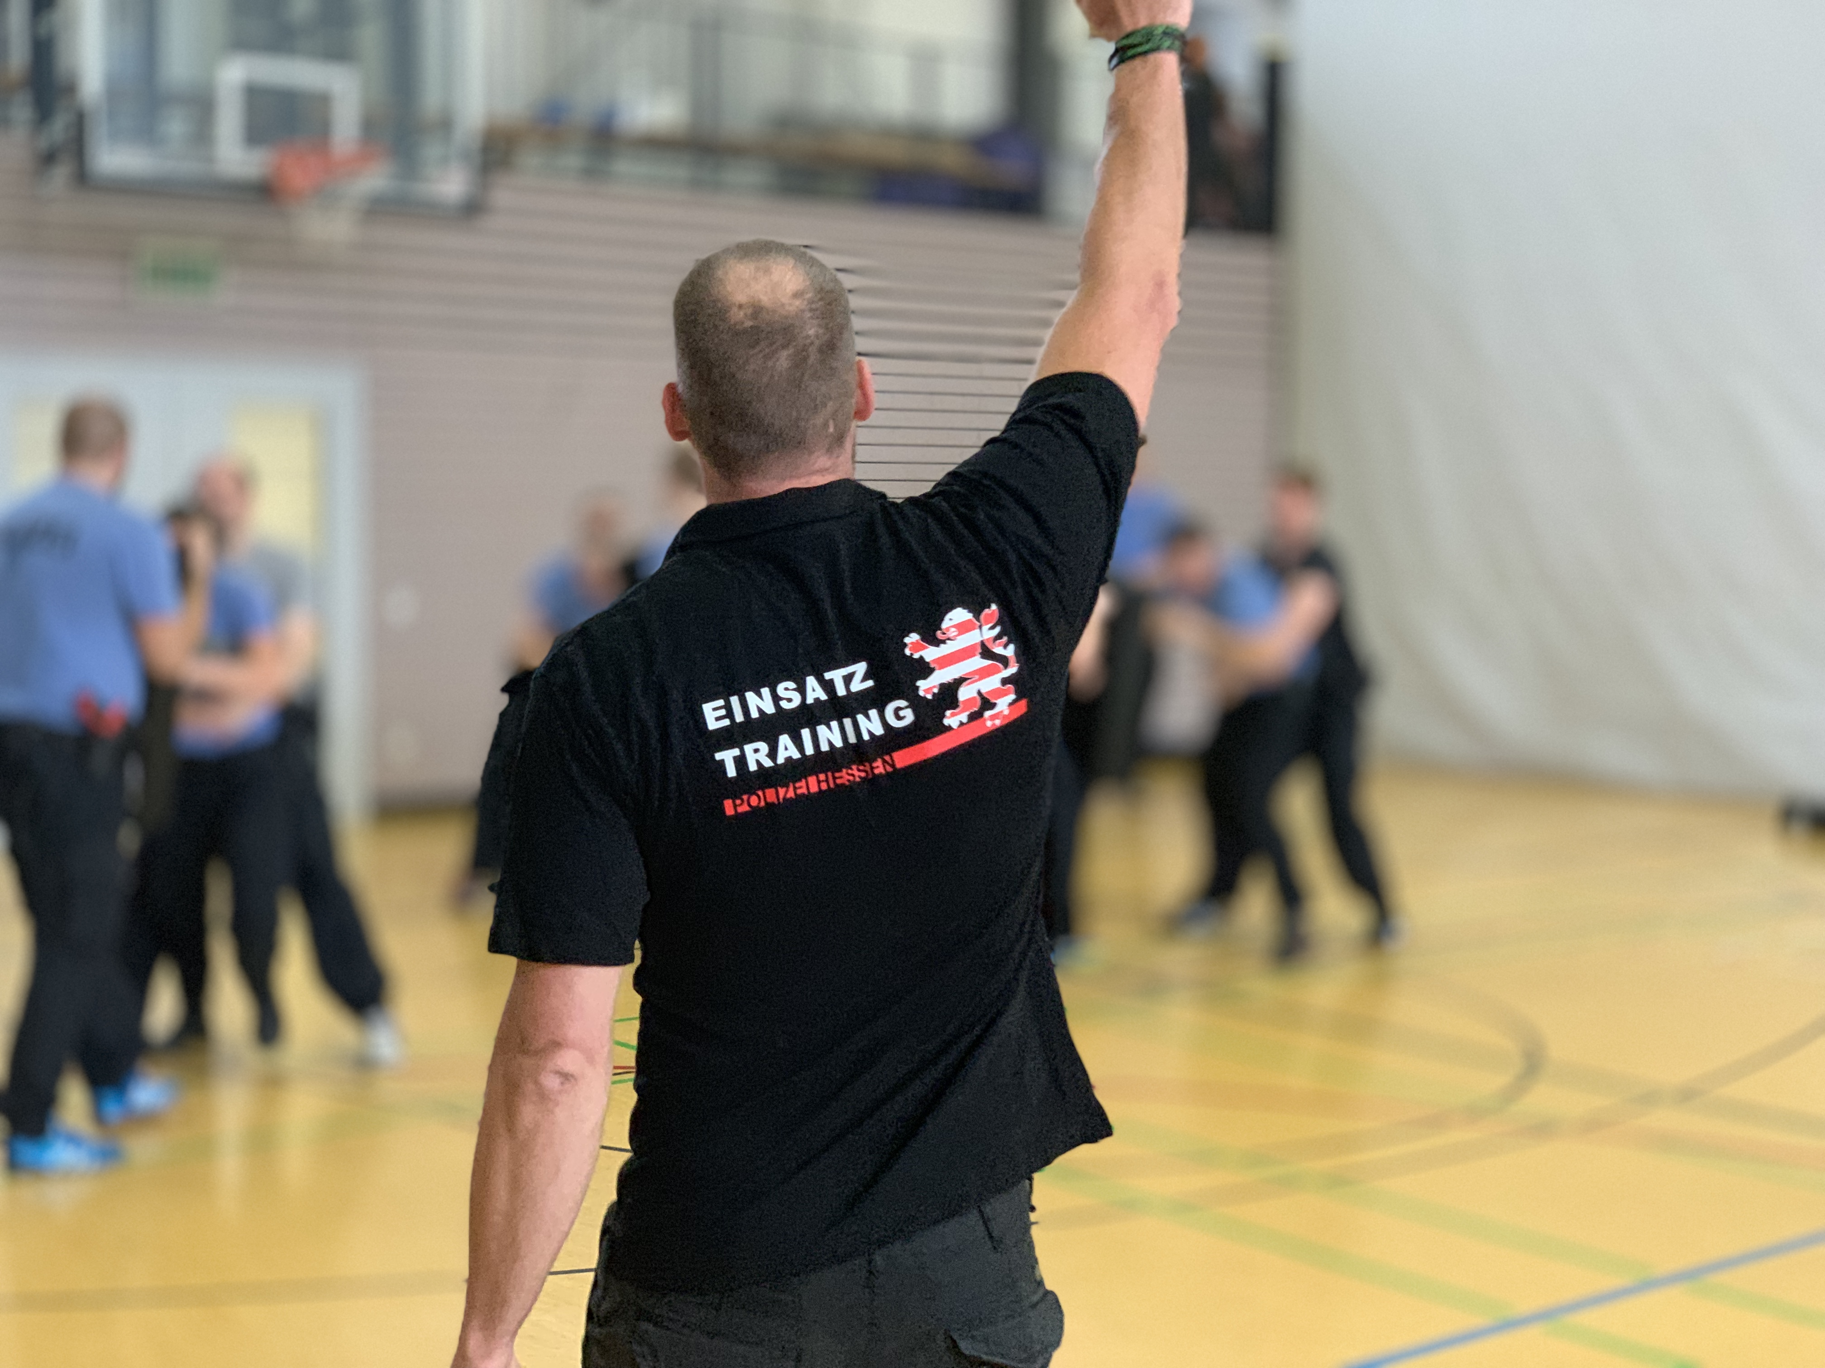
Problems in the Practice
of Conflict Management Training
in Germany
deficit-oriented view of recruits
(Koerner & Staller, 2022)
structural knowledge deficit
traditional pedagogy
(Koerner & Staller, 2021)
(Cushion, 2022, Staller et al., 2022)
unidimensional view on
conflict management
planning & reflection
(Staller et al., 2022)
(Staller et al., 2022)
inclination towards „hot shit“
(Staller & Koerner, 2022)
Staller, M. S., & Koerner, S. (2022). Einsatztraining und Digitalität. In T.-G. Rüdiger & P. S. Bayerl (Hrsg.), Handbuch Cyberkriminologie (S. 1–23). Springer VS. https://doi.org/10.1007/978-3-658-35450-3_50-1
Koerner, S., & Staller, M. S. (2022). “It has Changed, Quite Clearly.” Exploring Perceptions of German Police Trainers on Police Recruits. Frontiers in Education, 6. https://doi.org/10.3389/feduc.2021.771629
Staller, M. S., Koerner, S., Heil, V., Klemmer, I., Abraham, A., & Poolton, J. (2022). The Structure and Delivery of Police Use of Force Training: A German Case Study. European Journal for Security Research, 7(1), 87–112. https://doi.org/10.1007/s41125-021-00073-5

Slide 4
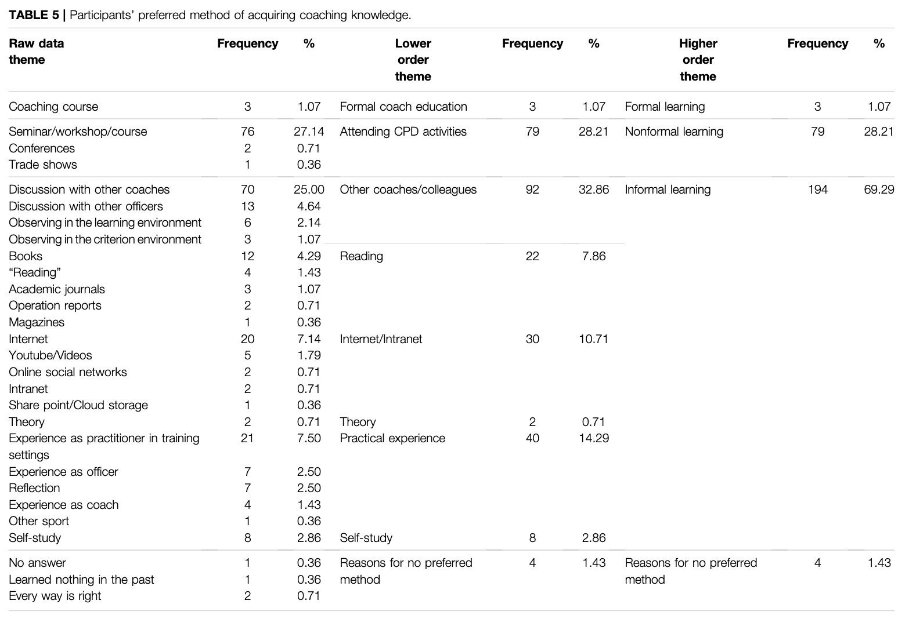
… and where does the knowledge come from
Coaching Knowledge Study
(N = 163)
(Staller et al., 2022)
Informal learning
as preferred
Method of Acquiring Knowledge
Koerner, S., & Staller, M. S. (2022). “It has Changed, Quite Clearly.” Exploring Perceptions of German Police Trainers on Police Recruits. Frontiers in Education, 6. https://doi.org/10.3389/feduc.2021.771629
Staller, M. S., Koerner, S., Abraham, A., & Poolton, J. M. (2022). Topics, Sources and Applicability of Coaching Knowledge in Police Training. Frontiers in Education. https://doi.org/10.3389/feduc.2022.730791

Slide 5
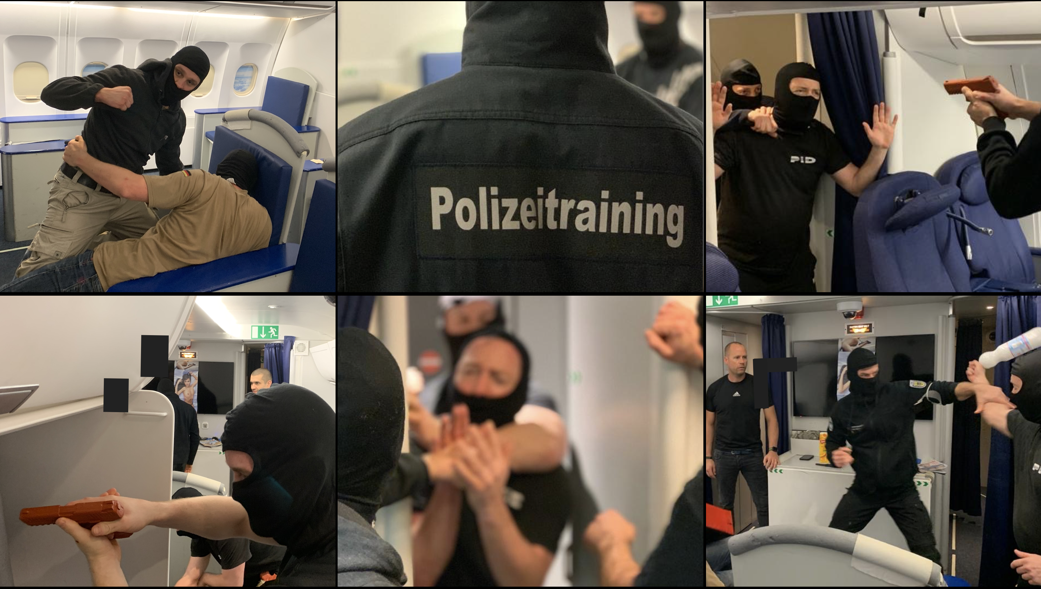
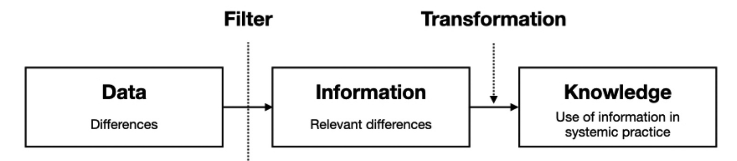
Our (Social Systems) Theory
Knowledge
Science
(Willke, 1998; Koerner & Staller, 2021)
The Police
Transformation
Filters of Selection
Willke, H. (1998). Organisierte Wissensarbeit. Zeitschrift Für Soziologie, 27(3), 161–177. https://doi.org/10.1515/zfsoz-1998-0301
Koerner, S., & Staller, M. S. (2021). From Data to Knowledge: Training of Police and Military Special Operations Forces in Systemic Perspective. Special Operations Journal, 7(1), 29–42. https://doi.org/10.1080/23296151.2021.1904571

Slide 6
Observed by
Selection Filters
Knowledge
Science
focus: content
true / false
The Police
(Pseudo)Scientific
(Bailey, et al., 2018)
(Frankfurt, 2009)
Bullshit
Transformation
Hot Shit
present / absent
(Mohr, 2018)
(Spicer, 2020)
current / not-current
Filters of Selection
*Same Data -
Different Theoretical Sense

Slide 7
„Wrong“ knowledge as the default
Sports Coaching
(Bailey et al., 2018)
41,6 % (SD = 26,3%) of Sports Coaches (N = 545) agreed with statements that promoted neuromyths
Different Perspectives
right / wrong vs.
systemic issues
our old perspective
our new perspective

Slide 8
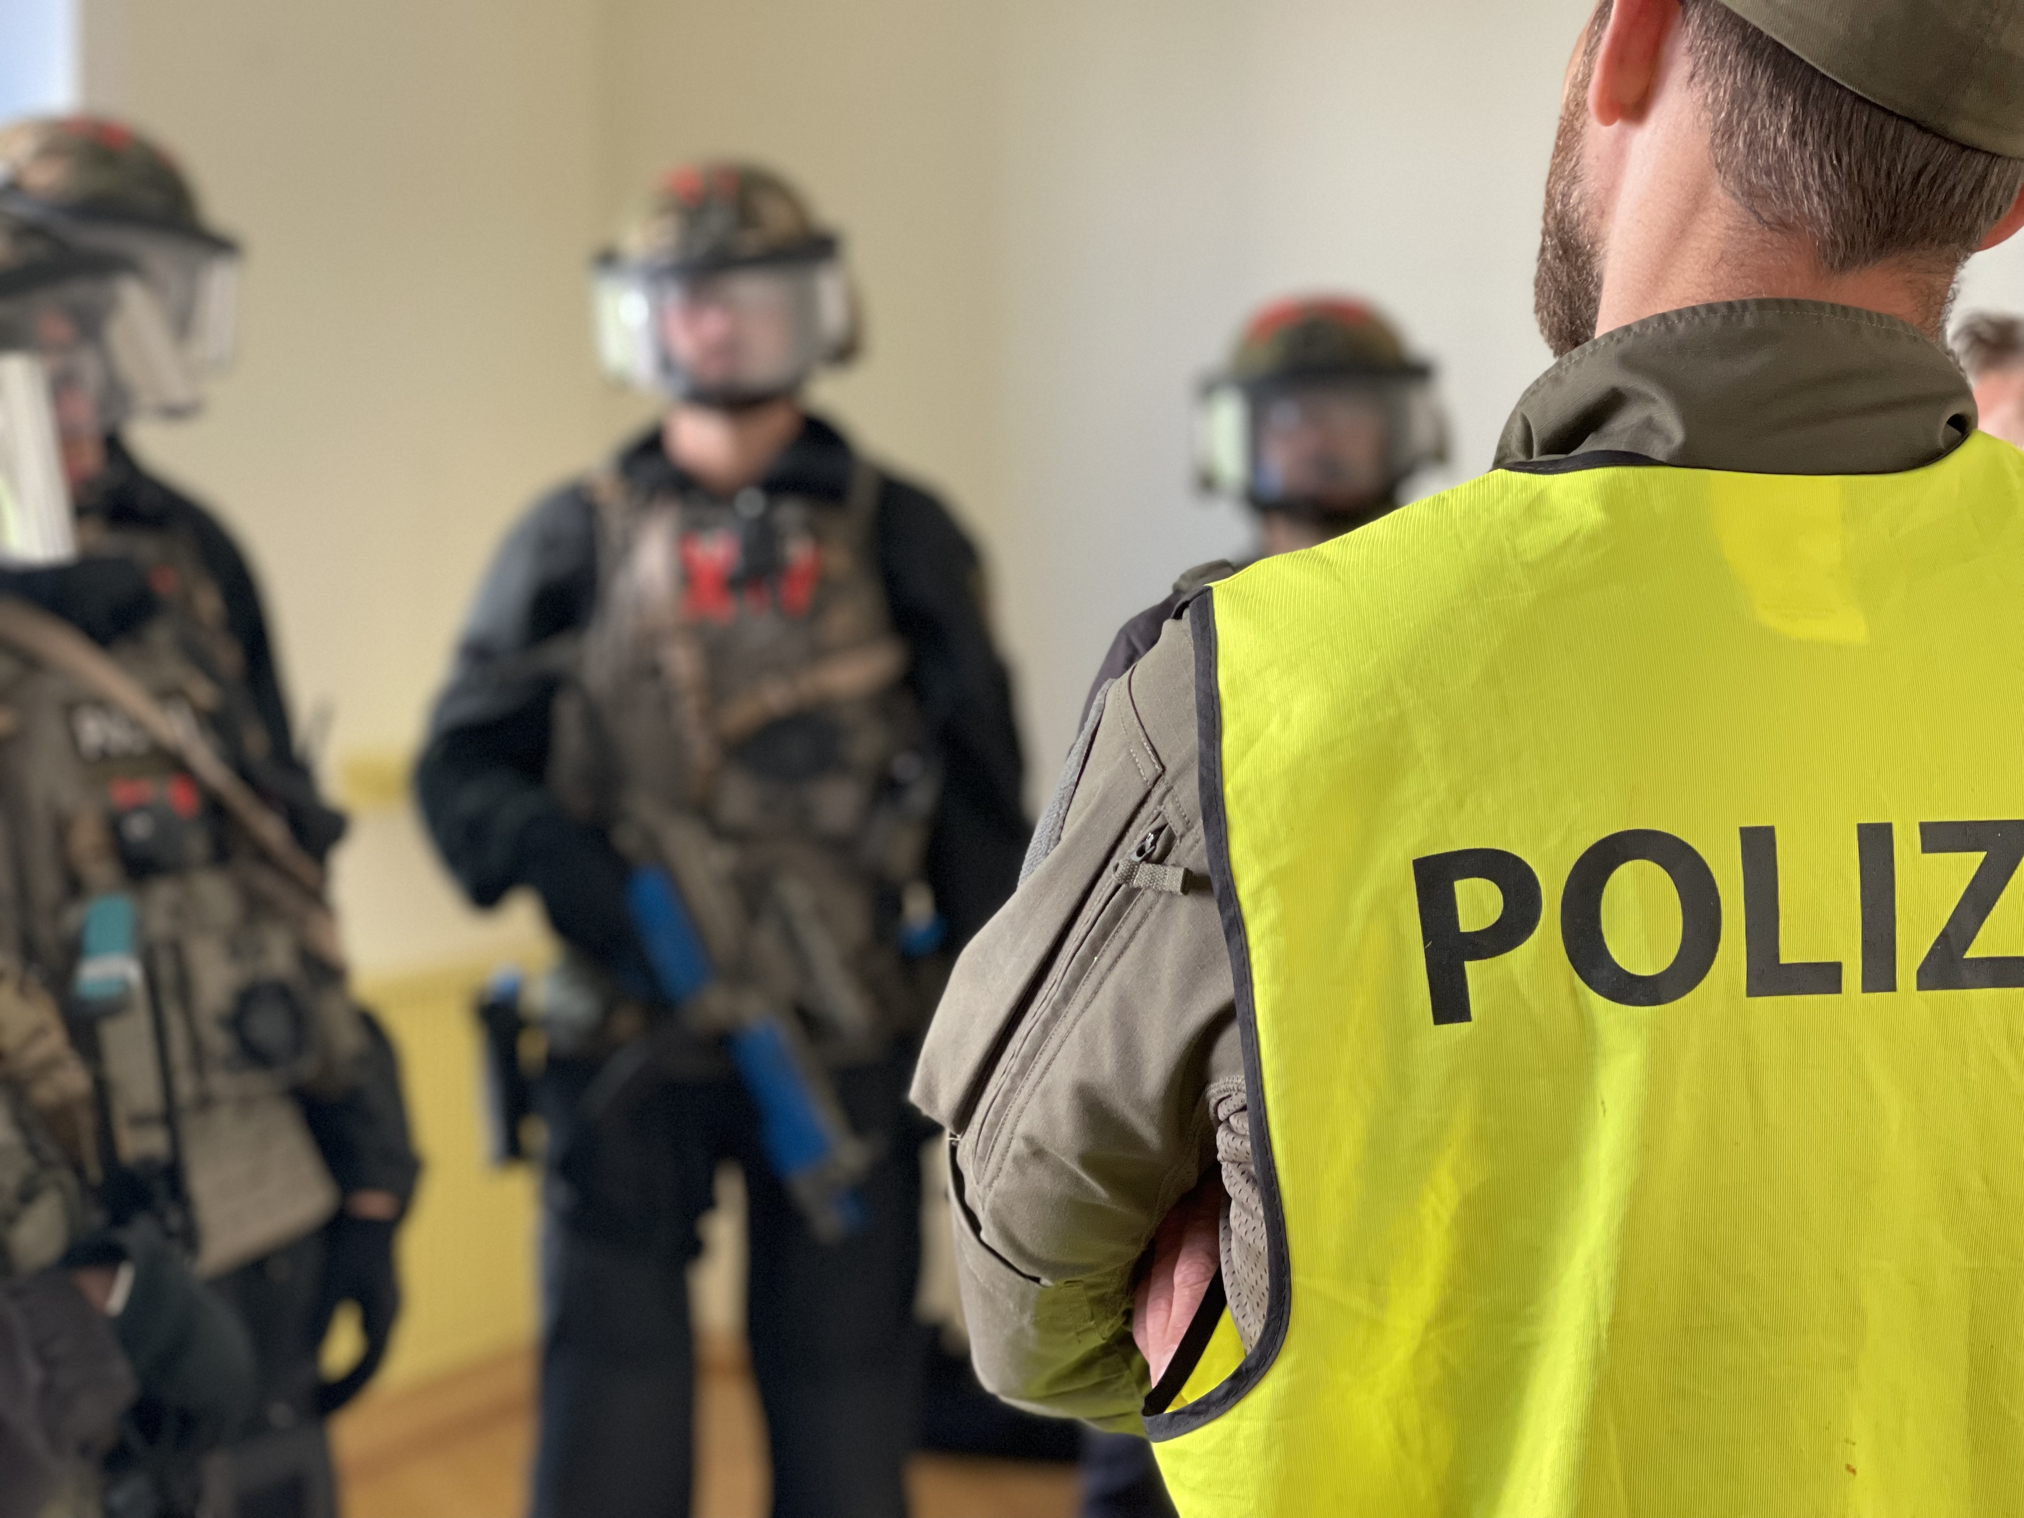
Coaches know what they know…
explicit & implicit
training pedagogy
training climate
views of society / the world
content
view of humans
conflict management
… and they act accordingly
(Matthews et al., 2023)
Matthews, C. R., Hurrell, A., Oliver, T. B., & Channon, A. (2023). Boxing, myths and reality building in sport for development programmes. International Review for the Sociology of Sport, 58(3), 531–549. https://doi.org/10.1177/10126902221112878
Koerner, S., & Staller, M. S. (2022). “It has Changed, Quite Clearly.” Exploring Perceptions of German Police Trainers on Police Recruits. Frontiers in Education, 6. https://doi.org/10.3389/feduc.2021.771629
Staller, M. S., Koerner, S., Abraham, A., & Poolton, J. M. (2022). Topics, Sources and Applicability of Coaching Knowledge in Police Training. Frontiers in Education. https://doi.org/10.3389/feduc.2022.730791

Slide 9
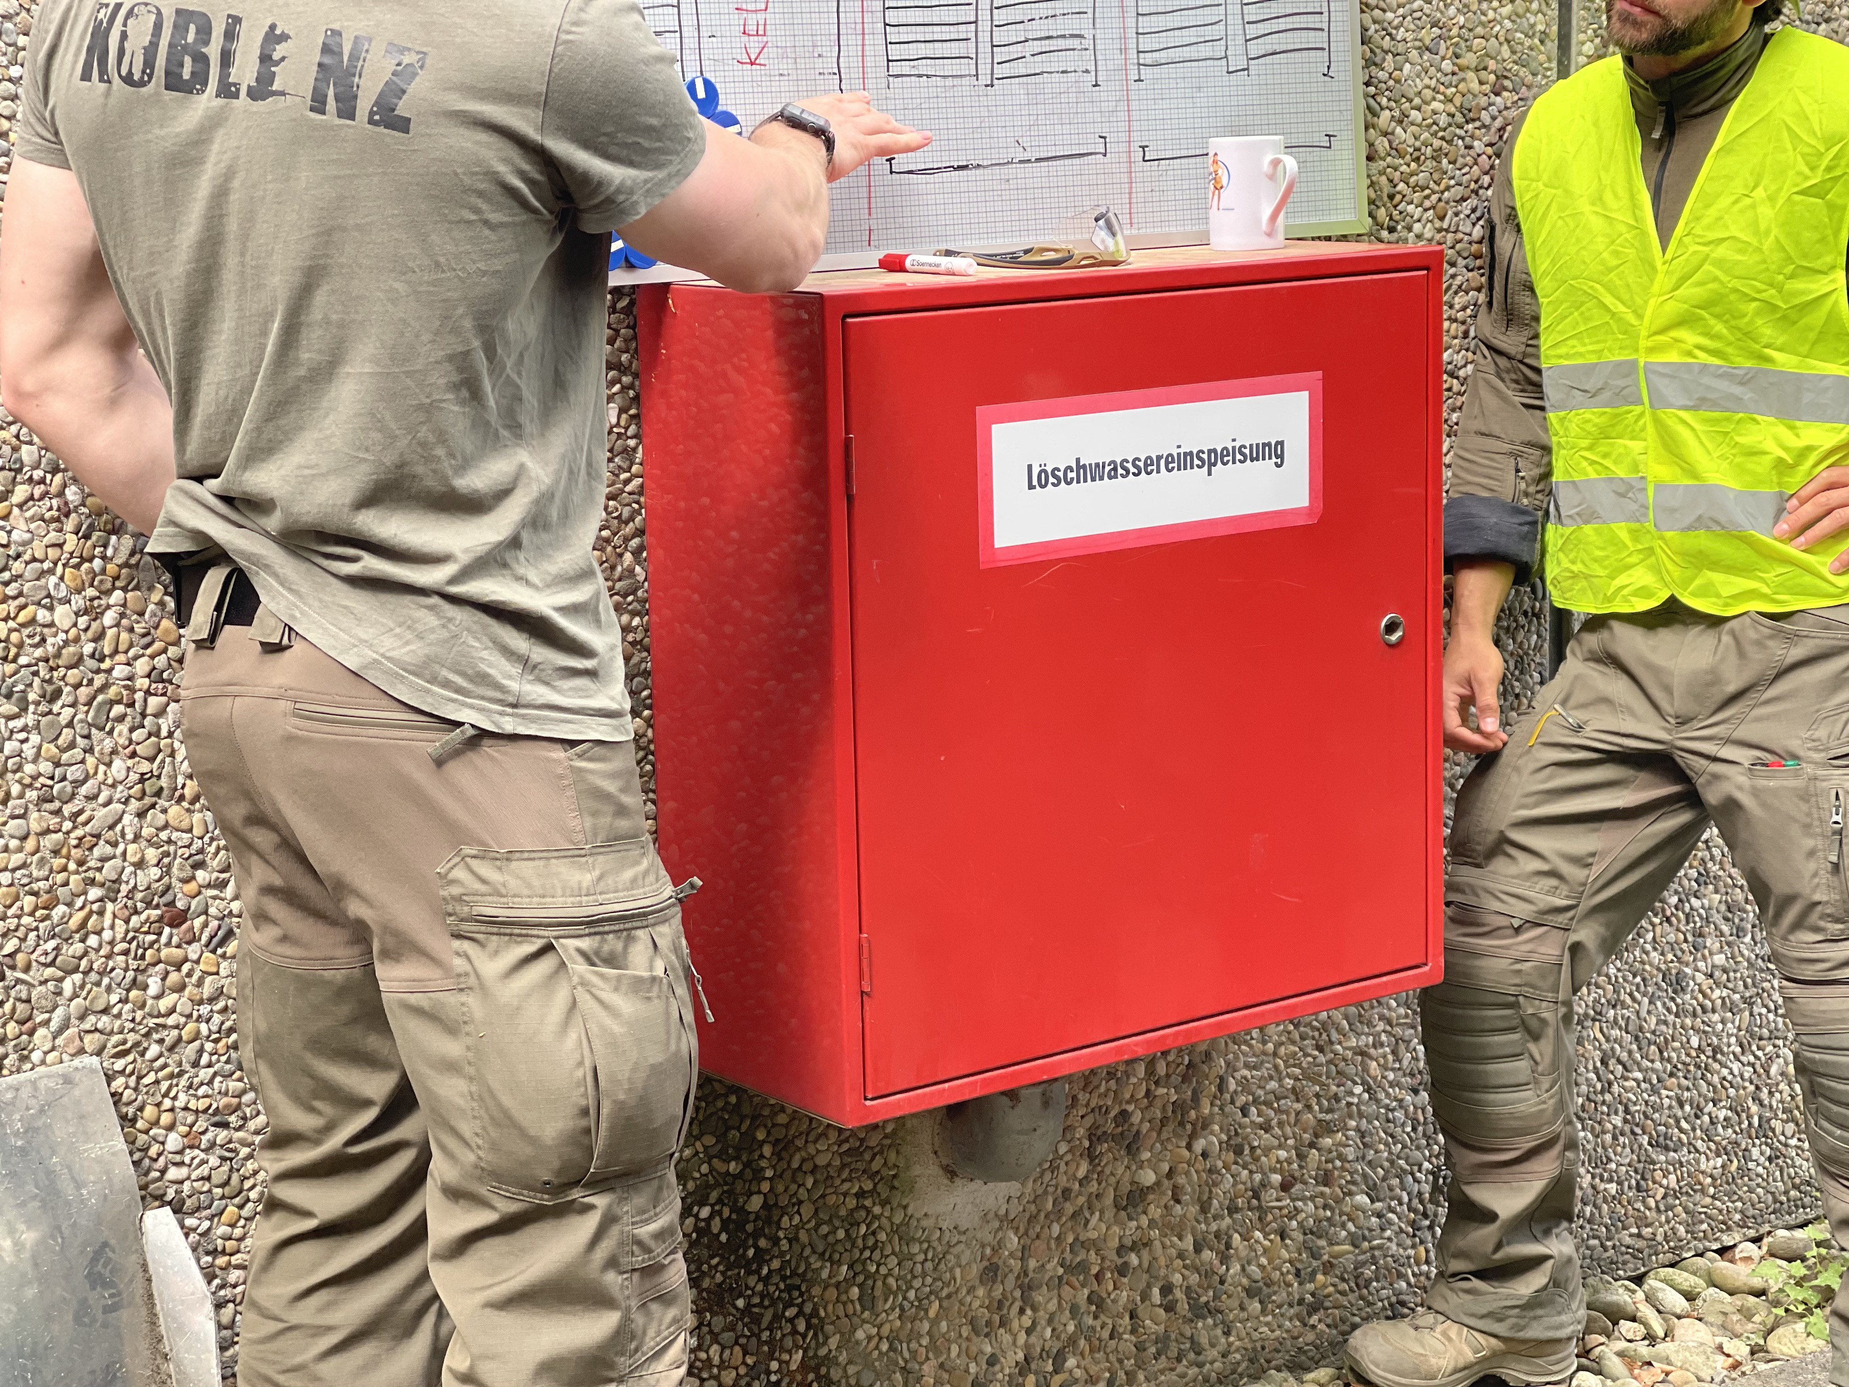
Learners know what the know…
explicit & implicit
Individual
Knowledge
Organisation
Koerner, S., & Staller, M. S. (2022). “It has Changed, Quite Clearly.” Exploring Perceptions of German Police Trainers on Police Recruits. Frontiers in Education, 6. https://doi.org/10.3389/feduc.2021.771629
Staller, M. S., Koerner, S., Abraham, A., & Poolton, J. M. (2022). Topics, Sources and Applicability of Coaching Knowledge in Police Training. Frontiers in Education. https://doi.org/10.3389/feduc.2022.730791

Slide 10
Our Study Aim
*
Knowledge
Science
The Police
Transformation
Filters of Selection
focus: structure
*Based on a change in our perspective

Slide 11
Our Study Aim
Knowledge
Science
The Police
Transformation
Filters of Selection
focus: structure

Slide 12
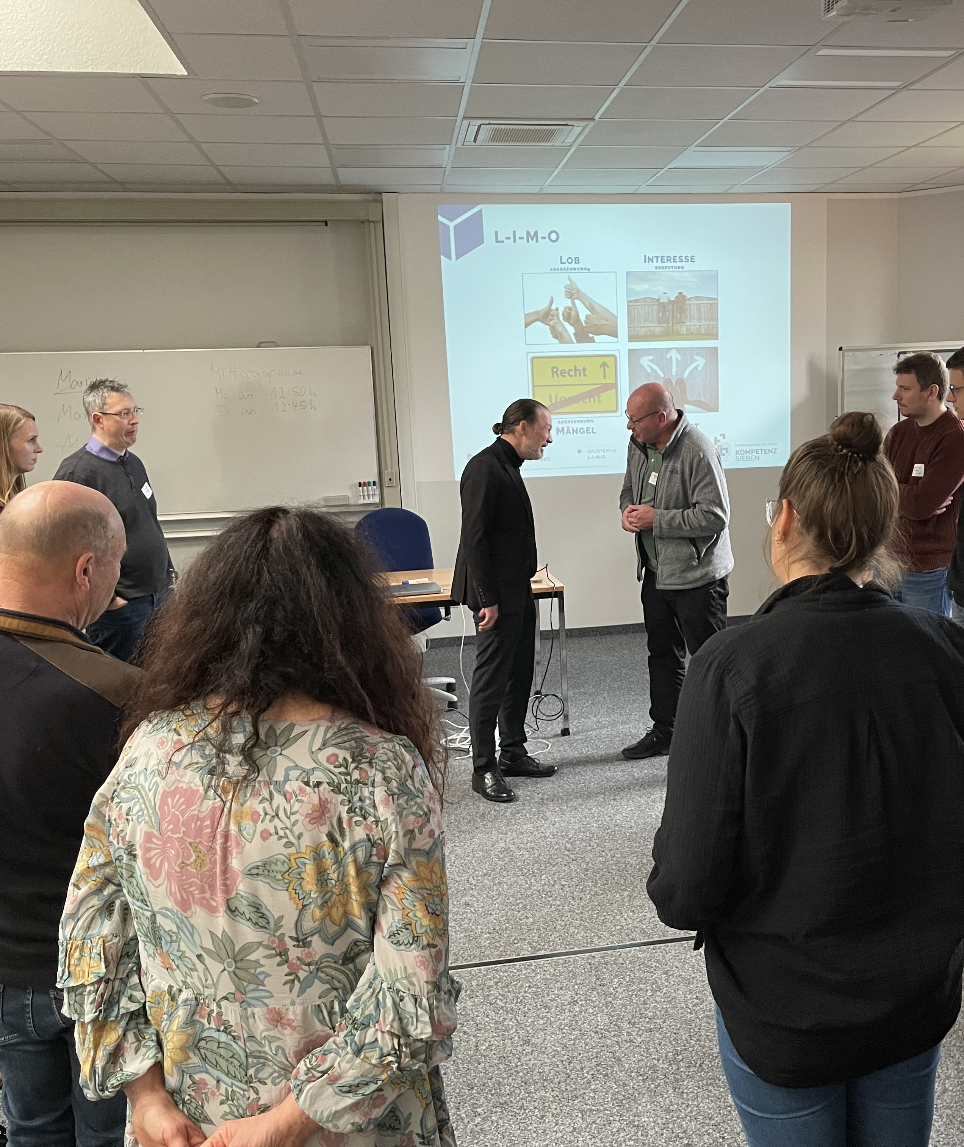
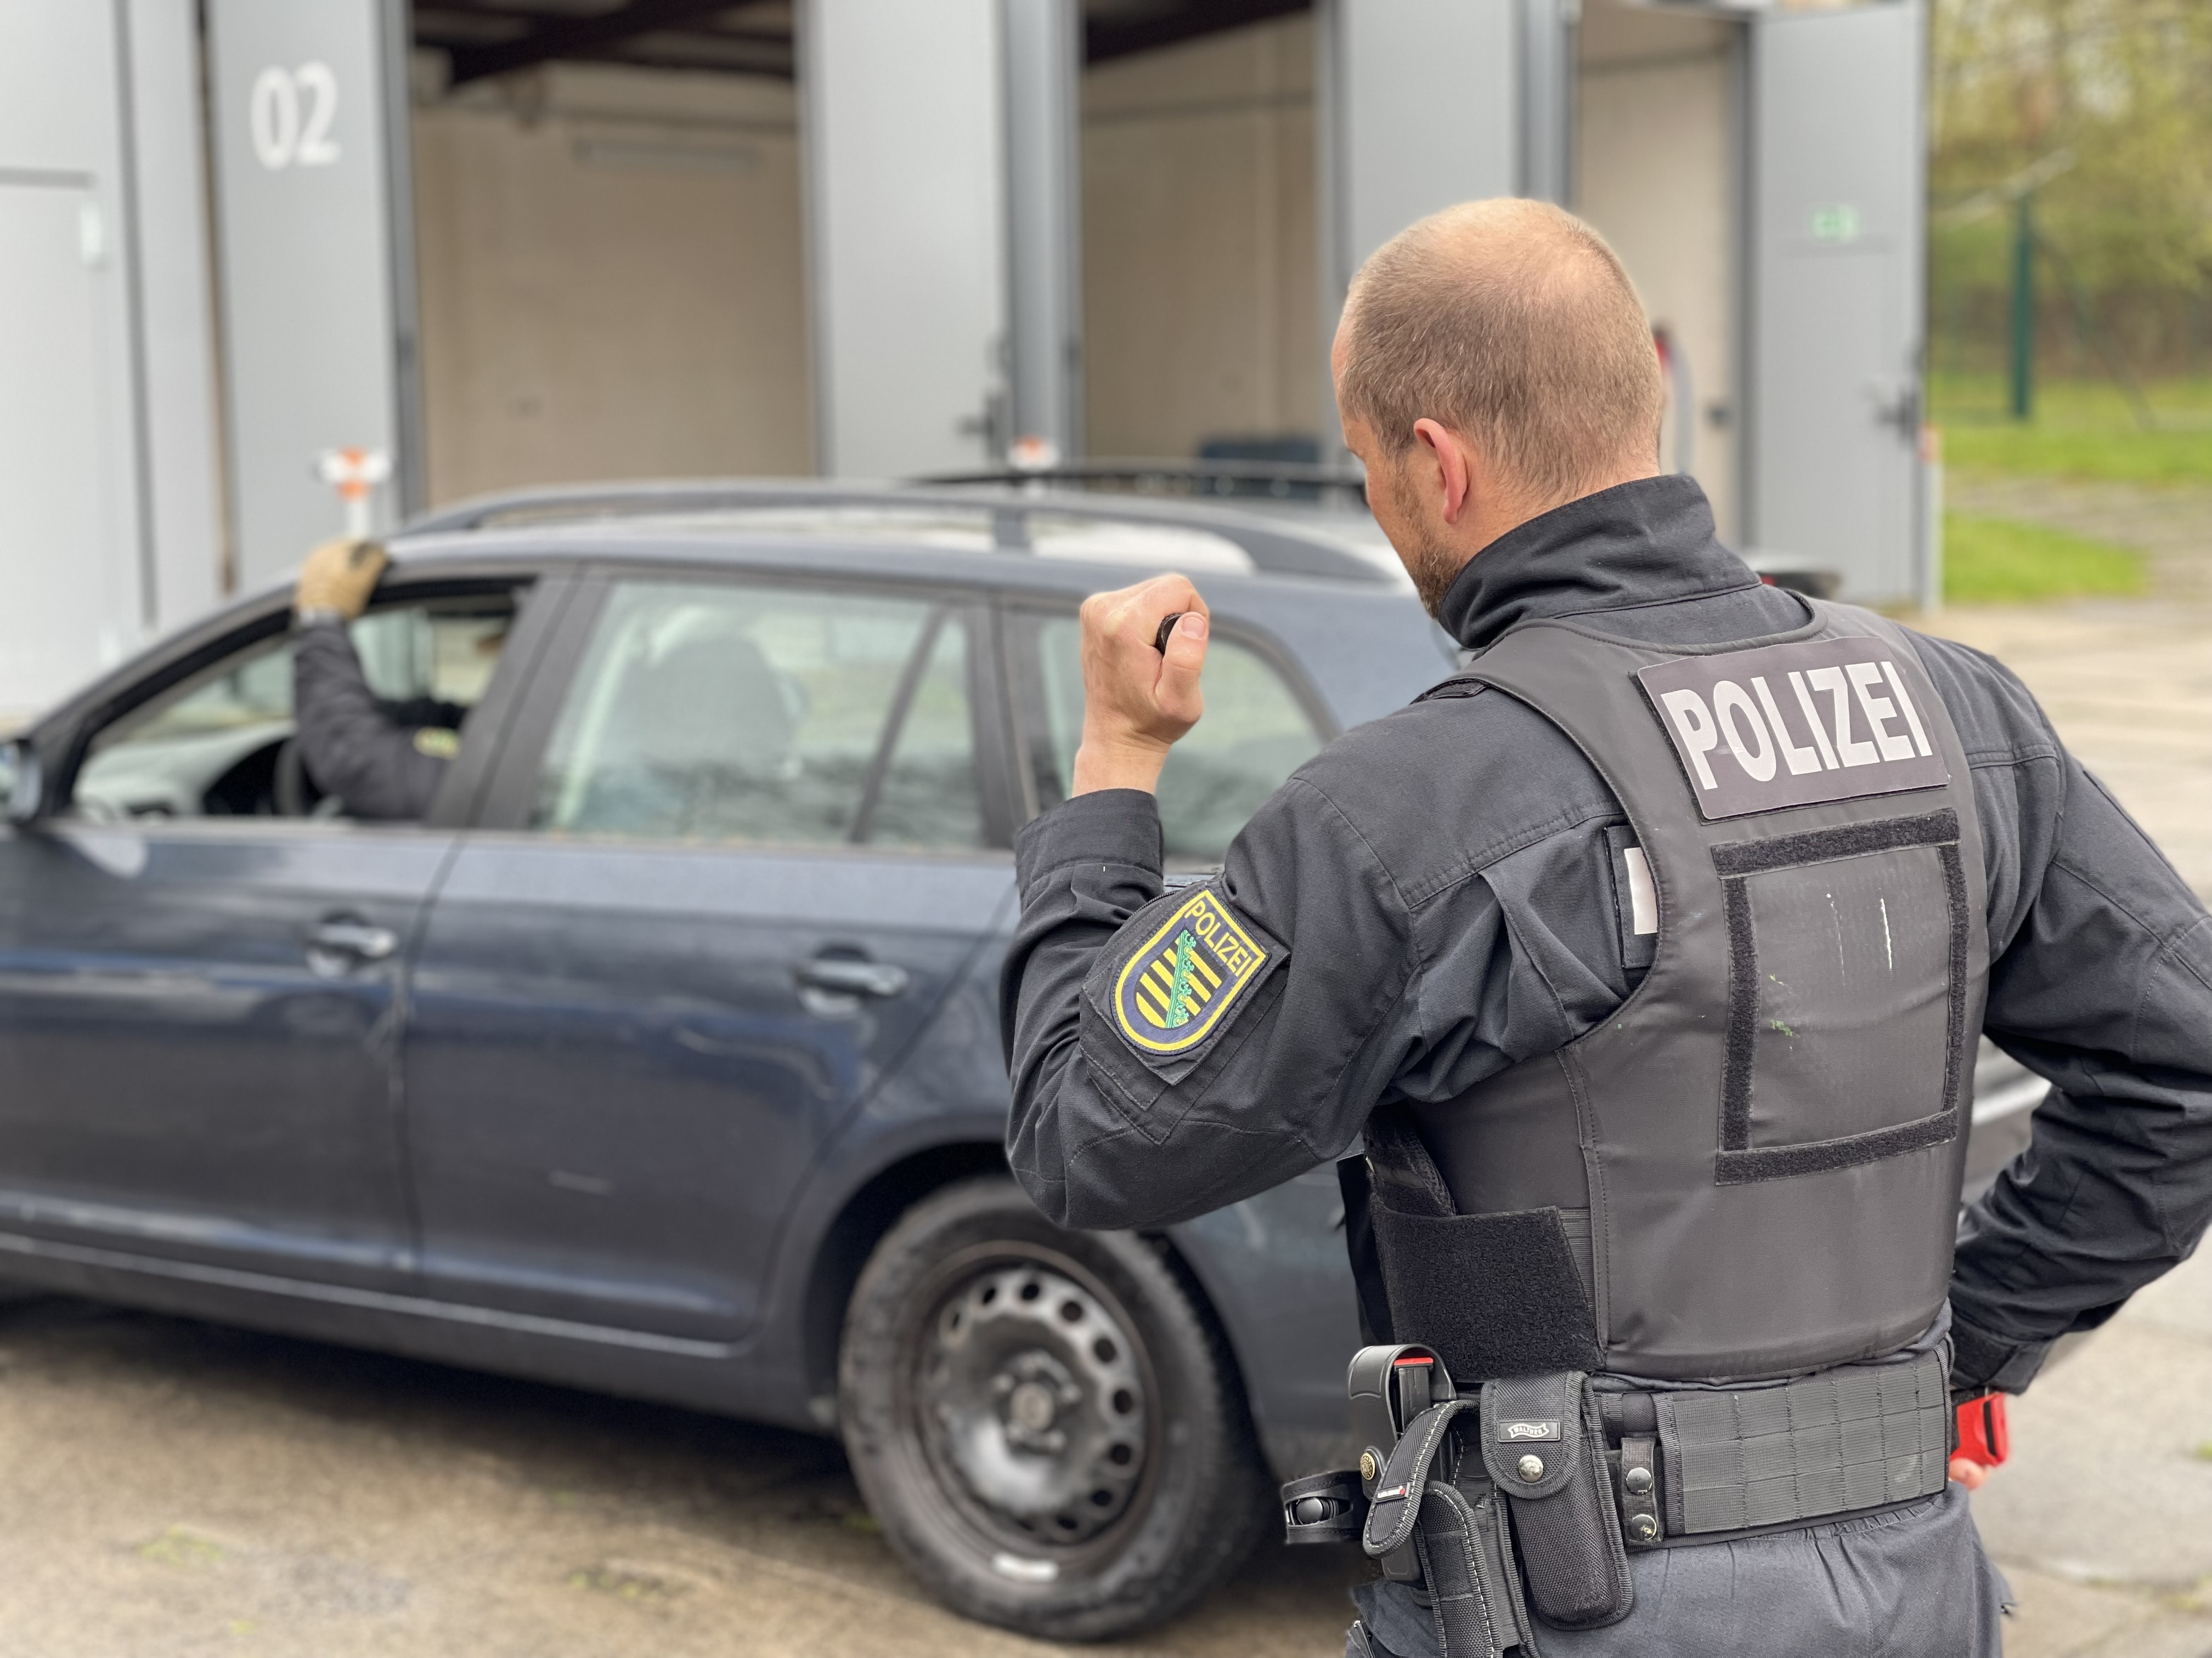
Social Competence Training
Police Use
of Force
Training
(Staar, Zeitner & Zeitner, 2022)
(Staller & Körner, 2022)
Different Relevance Filters ?
n = 63 / n = 186

Slide 13
Learning, Coaching
Conflict Management
Measures
Sources of Information
Awareness/Contact and Use of Concepts: 32
Belief in statements about L, C, and CM: 44
n = 63 / n = 186

Slide 14
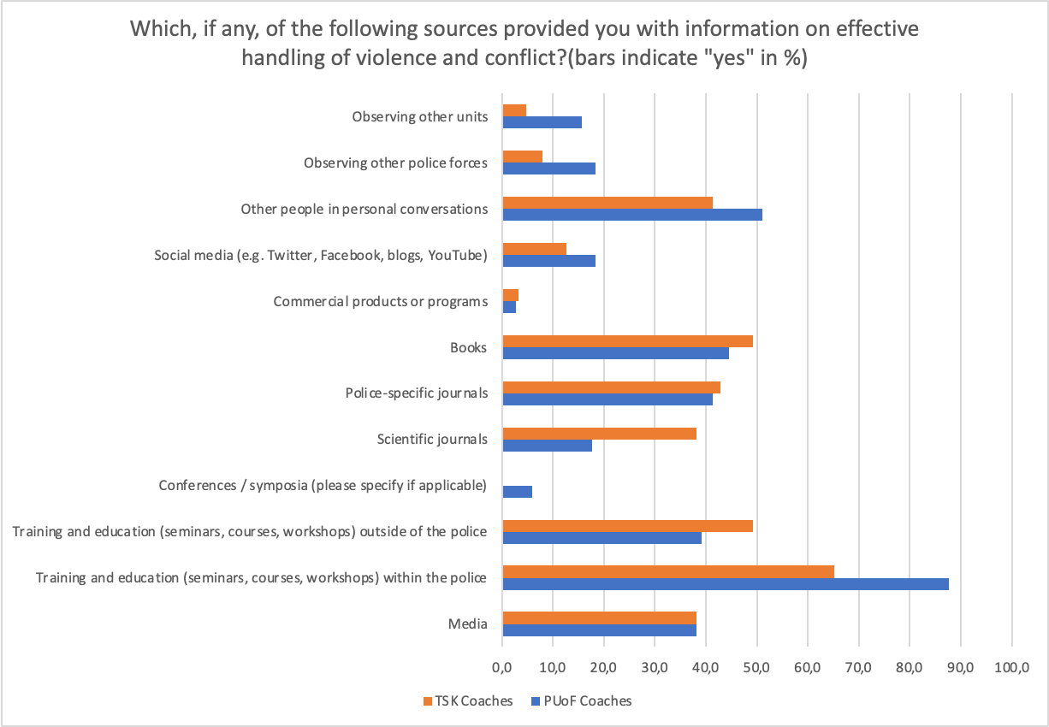
Sources
of
Information
Conflict Management
statistically significant
at p < .05

Slide 15
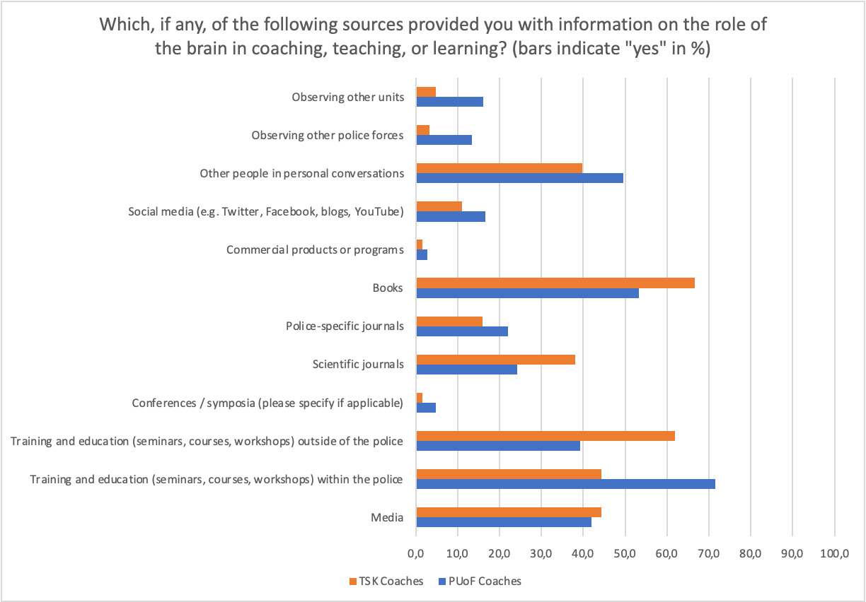
Sources
of
Information
Coaching, Learning
statistically significant
at p < .05

Slide 16
Social Competence Training
Police Use
of Force
Training
Sources
of
Information
Observable Tendency
system extern
system intern
openness
closeness

Slide 17
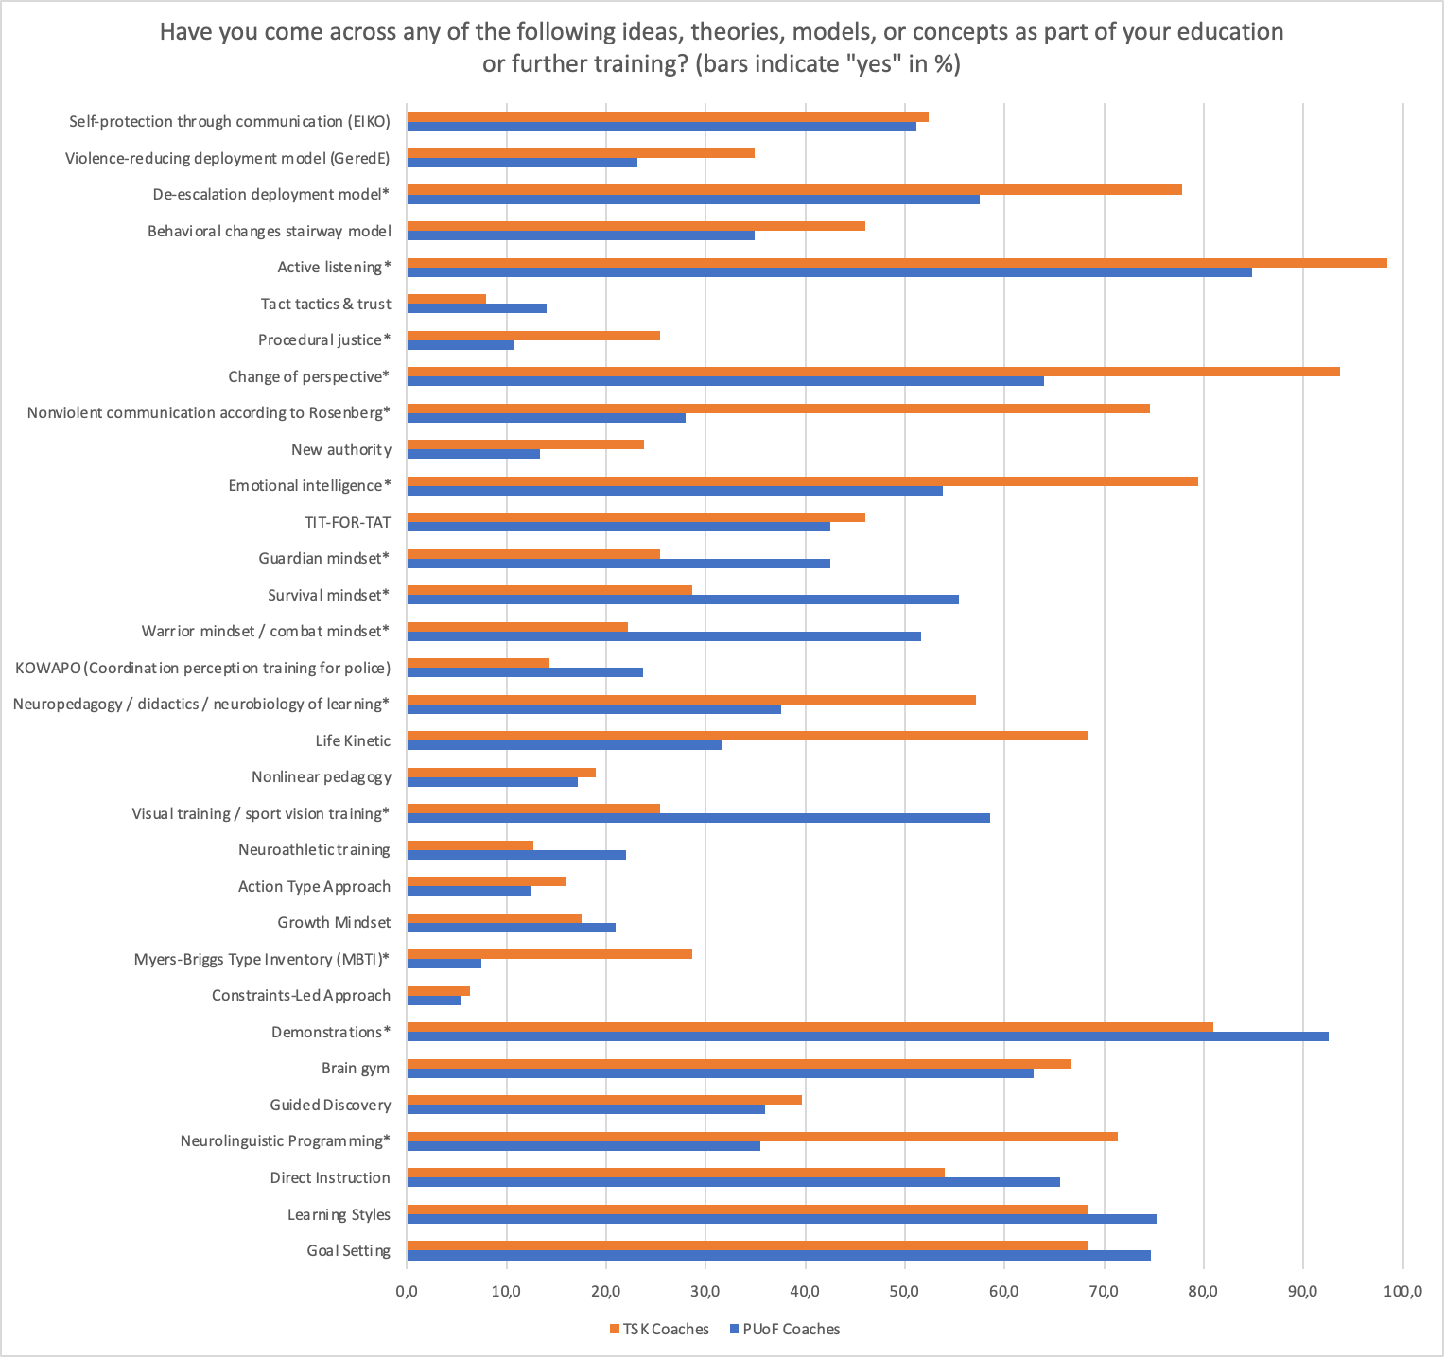
conflict management
Contact with Concepts
Use of Concepts
coaching, teaching, learning

Slide 18
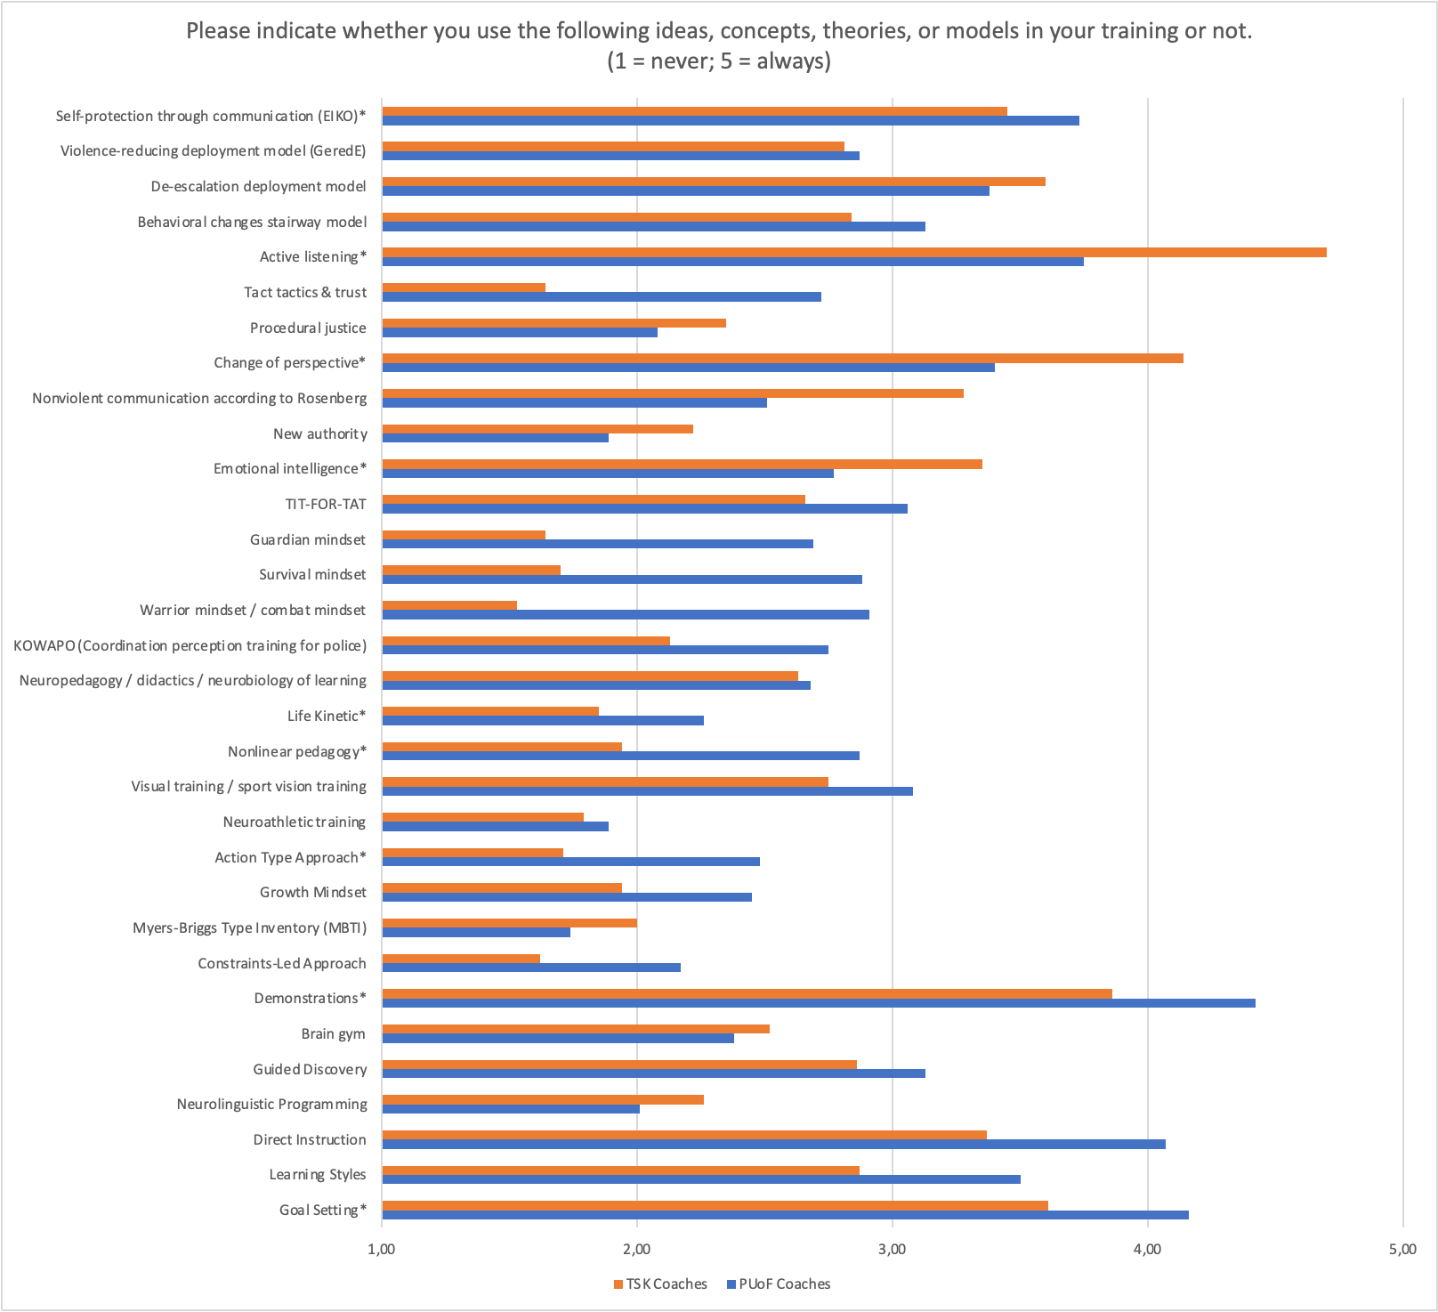
conflict management
Contact with Concepts
Use of Concepts
coaching, teaching, learning

Slide 19
Social Competence Training
Police Use
of Force
Training
Contact with Concepts
Use of Concepts
Observable Tendency
Soft Skills
Hard Skills

Slide 20
Belief in statements

Slide 21
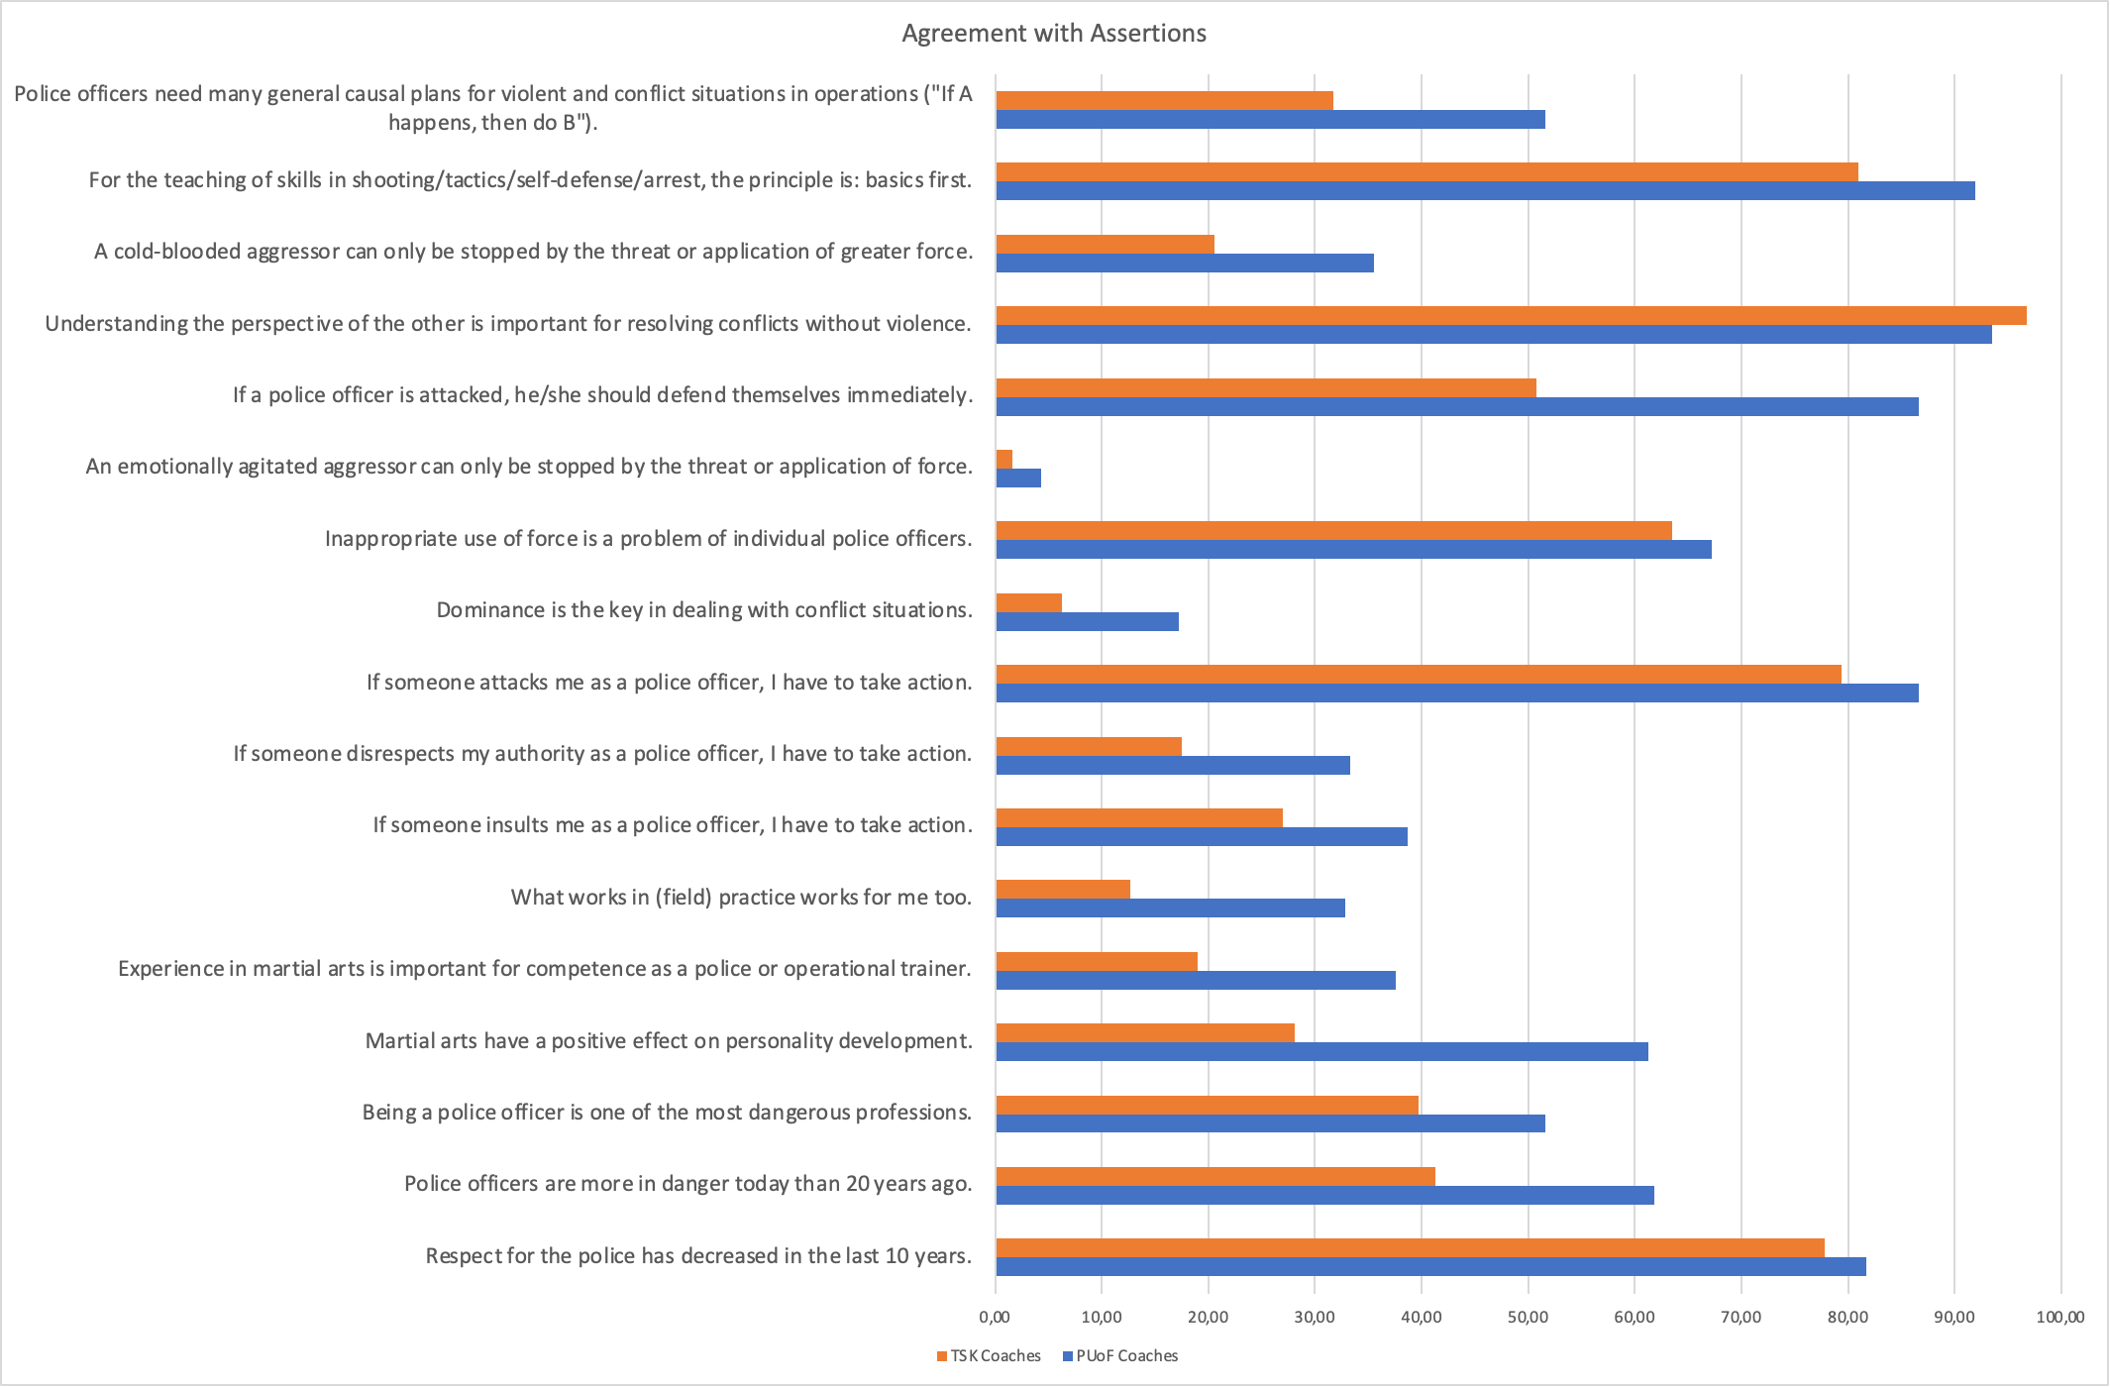
Conflict Management
Conflict Behavior
Martial Arts Knowledge
(Myths)
Danger Perception
Notes:
Note: MA als biographical background jetzt final auswerten und paper

Slide 22
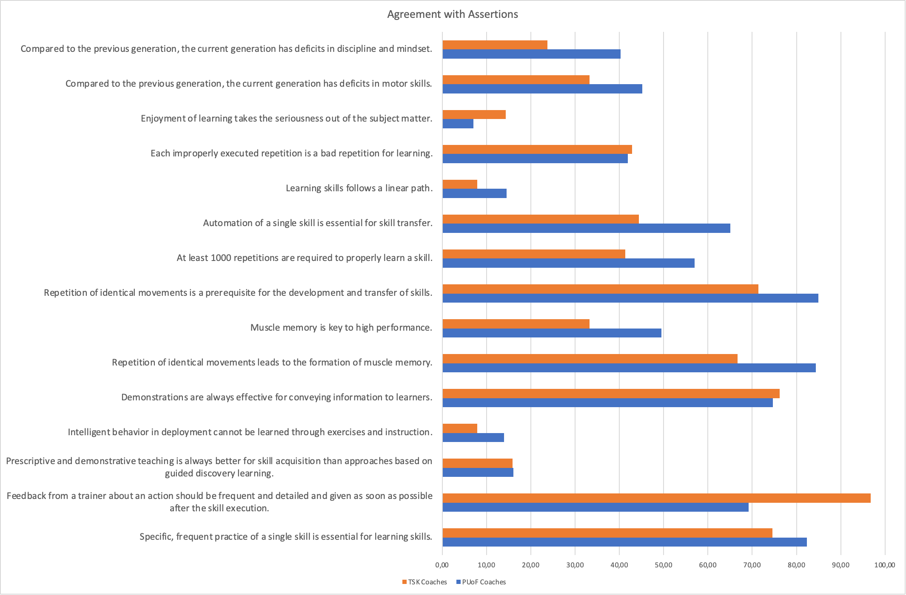
Coaching
Knowledge

Slide 23
Social Competence Training
Police Use
of Force
Training
Belief in statements
Observable Tendency
Soft Skills
Hard Skills

Slide 24
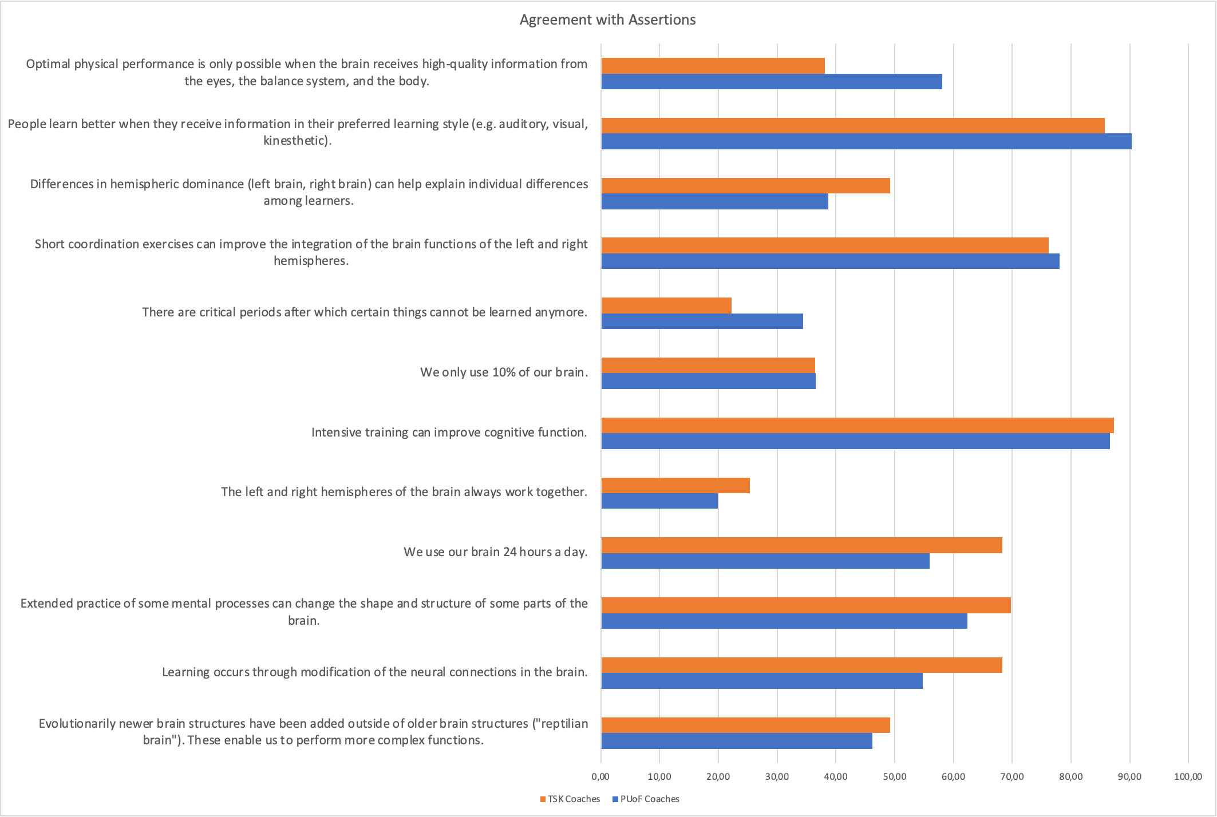
Brain
Results
Neuomyth & Assertions about the Brain
(Bailey et al., 2018)

Slide 25
Discussion
open / closed
soft / hard
Knowledge
Science
in different
Sub-Systems
Police
From Data to Knowledge
Structural Filter

Slide 26
Further Research
Reflexivity
In-System
Knowledge Creation
(Limitations)
Community of Practice
No In-System Observation
(Wilke, 1999)
Epistemic Humility
(Breznau et al., 2022)
Structure of Conflict Management Training?
Individual vs.
organisational
relevance filter
Social Competence vs.
Police Use of Force
Autopoesis of
sub-systems
(Wilke, 1999)
(Staller & Körner, 2022)
(Luhmann, 1984)
Implications
Breznau, N., Rinke, E. M., Wuttke, A., Nguyen, H. H. V., Adem, M., Adriaans, J., Alvarez-Benjumea, A., Andersen, H. K., Auer, D., Azevedo, F., Bahnsen, O., Balzer, D., Bauer, G., Bauer, P. C., Baumann, M., Baute, S., Benoit, V., Bernauer, J., Berning, C., … Żółtak, T. (2022). Observing many researchers using the same data and hypothesis reveals a hidden universe of uncertainty. Proceedings of the National Academy of Sciences, 119(44), e2203150119. https://doi.org/10.1073/pnas.2203150119

Slide 27
Mario S. Staller, Swen Koerner, Benni Zaiser
From
Knowledge to
Information
The Marking of Relevance of
Police Use of Force Trainers
& Social Competence Coaches
Seventh Annual Conference of the American Society of Evidence-Based Policing
University of Nevada, Las Vegas, May 15-17th, 2023

